Slide 1
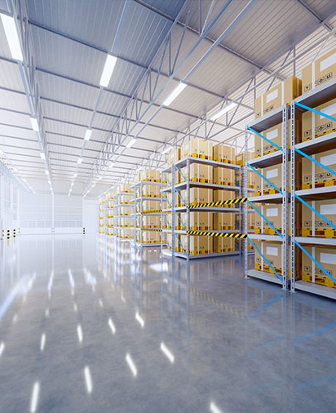
CAPSTONE PROJECT
SUPPLY CHAIN OPTIMIZATION
BY
KARTHIKEYAN MP

Slide 2
Business Problem Understanding
Problem Statement
A FMCG company has entered into the instant noodles business two years back.
The management noticed that there is a miss match in the demand and supply leading to inventory cost loss .
Hence, the higher management wants to optimize the supply quantity in each and every warehouse in entire country.
Constraints
The company has shared very limited information.
Scope
Various Regression models to be built to predict the optimum weight to be shipped.
Demand and supply patterns of each warehouse to be studied.
Demand trends in different pockets of the country to be analyzed.
Objectives
Model for predicting optimum weight to be shipped for each warehouse.
Insights about demand patterns in different pockets of country.

Slide 3
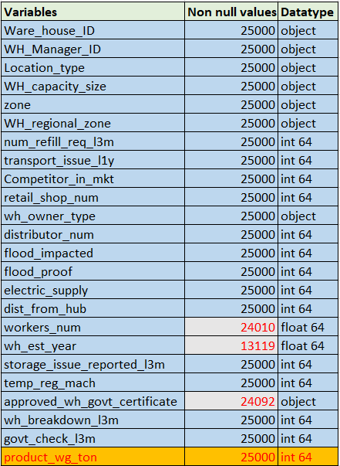
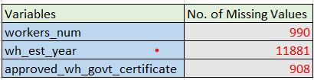
Modelling Approach Used & Why?
1. Exploratory Data Analysis (EDA)
DATASET INFO
# NO. OF PEDICTOR VARIABLES = 23
# TARGET VARIABLE : product _ wg _ ton
MISSING VALUES

Slide 4
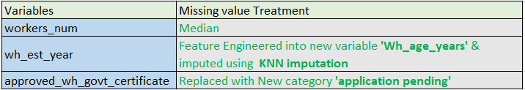
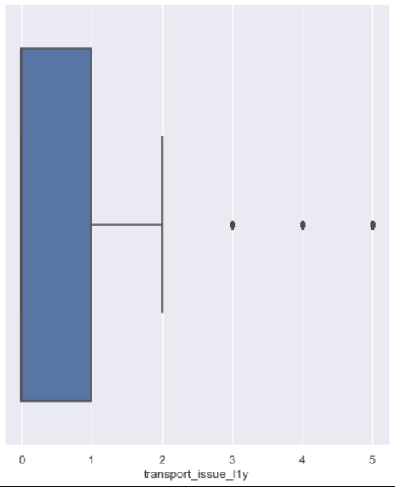
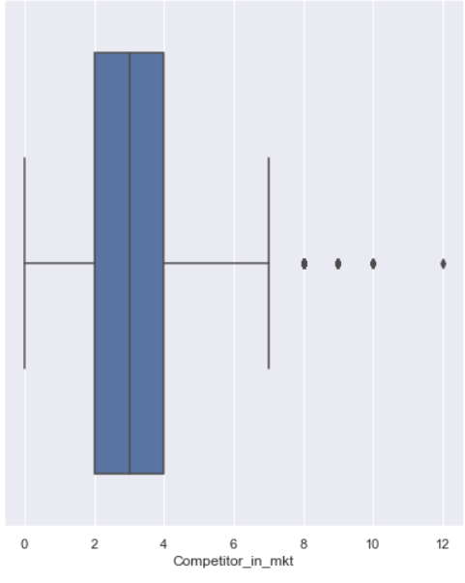
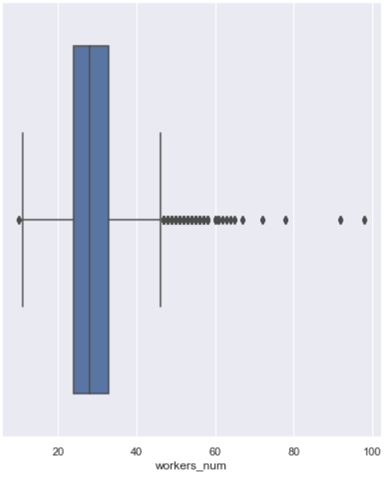
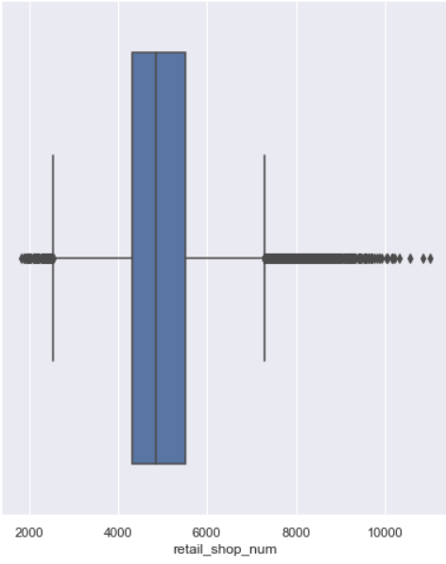
MISSING VALUE TREATMENT
OUTLIER DETECTION (Using Box plot)
1.transport_issue_l1y 2.Competitor_in_mkt 3.workers_num 4.retail_shop_num

Slide 5
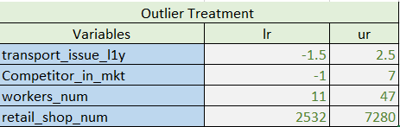
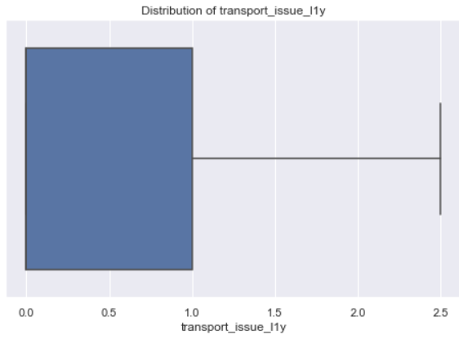
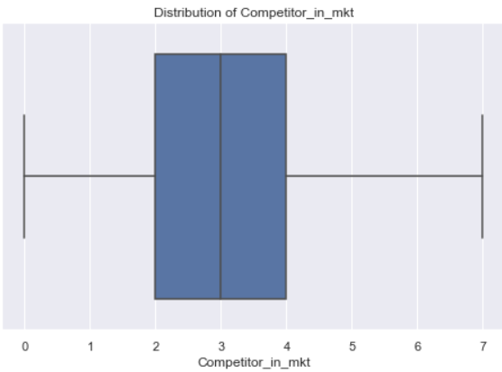
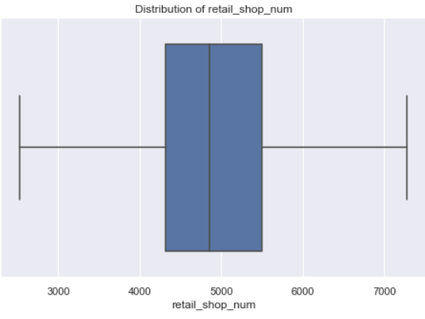
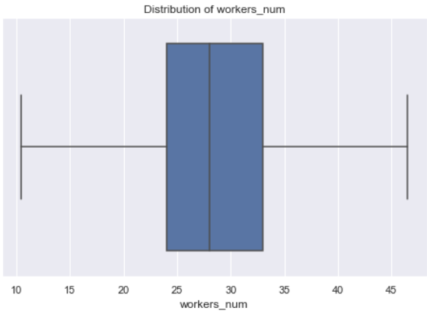
OUTLIER TREATMENT

Slide 6
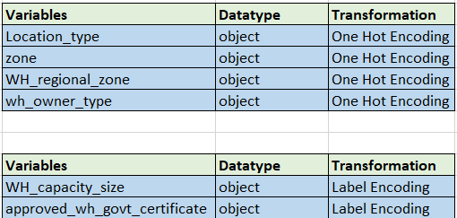

DATA TRANSFORMATION
DATA SPLIT

Slide 7
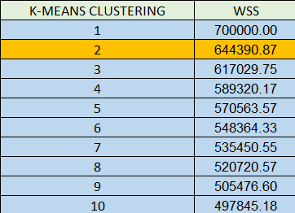
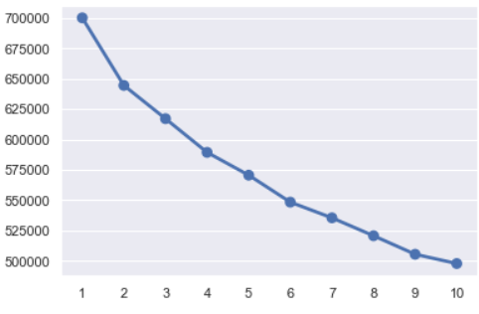

K-MEANS CLUSTERING
WSS PLOT

Slide 8
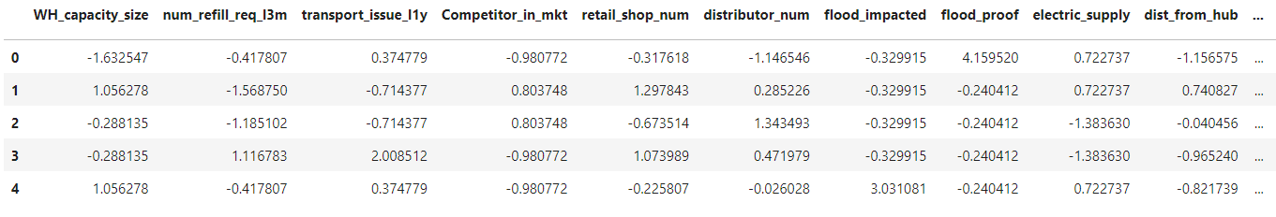
SCALING OF DATASET
SAMPLE DATASET SCALED

Slide 9
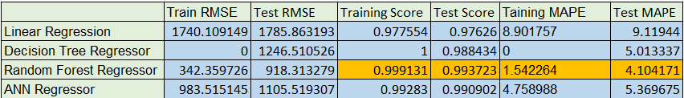
FOUR REGRESSION MODELS ARE BUILT
Linear Regression Model
Decision Tree
Random Forest
Artificial Neural Network –(Supplied scaled data)
MODEL EVALUATION

Slide 10

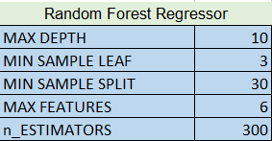
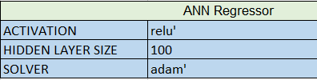
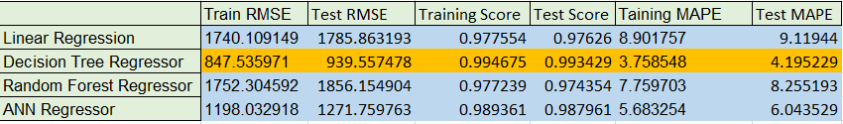
HYPER PARAMETER TUNING
MODEL EVALUATION

Slide 11
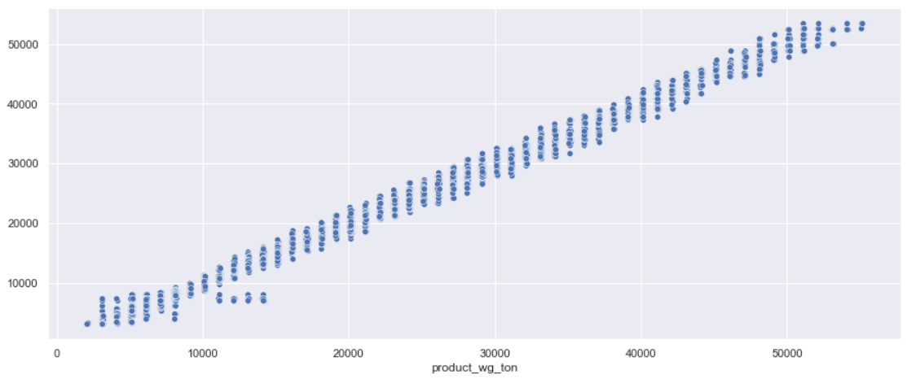
Pred V/s Actual For Best Model :Decision Tree

Slide 12
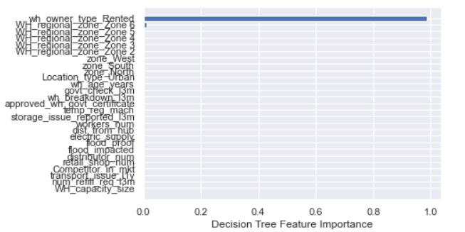
Feature Importance of Best Model :Decision Tree

Slide 13
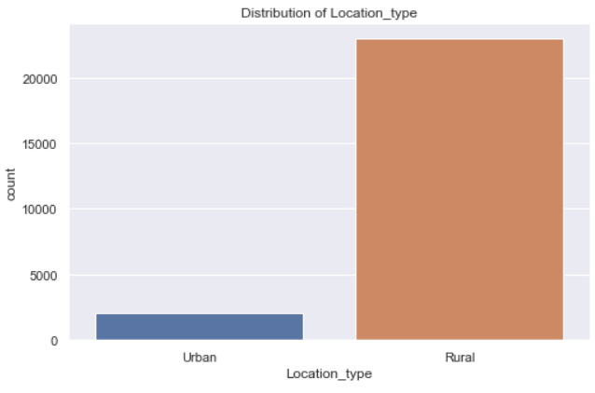
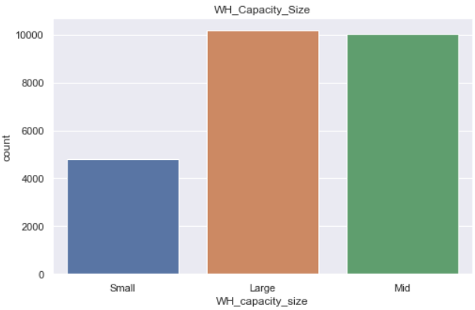

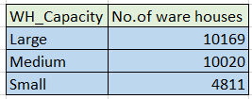
Insights from Analysis

Slide 14
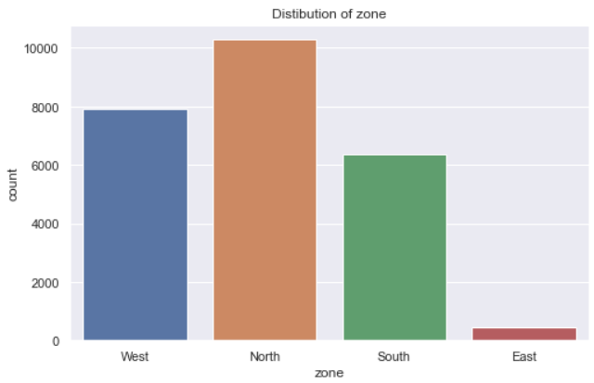
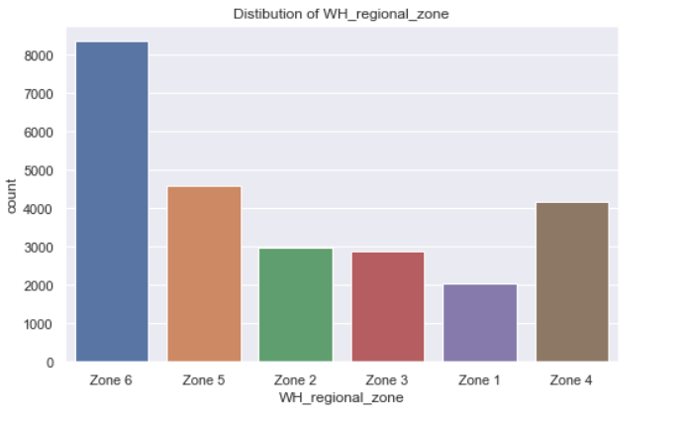
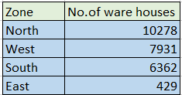
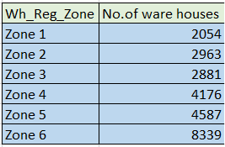

Slide 15
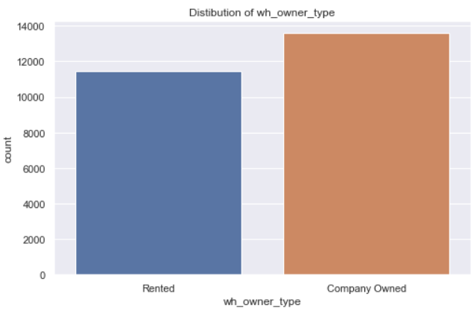
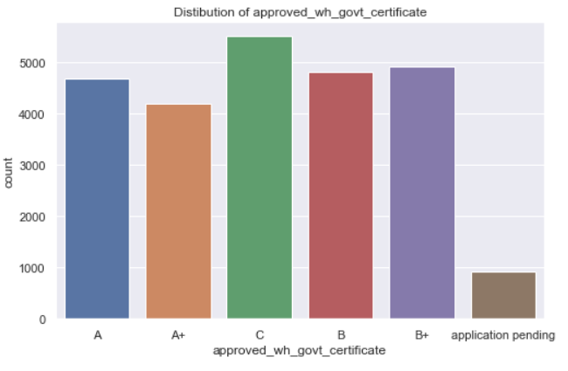

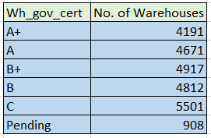

Slide 16
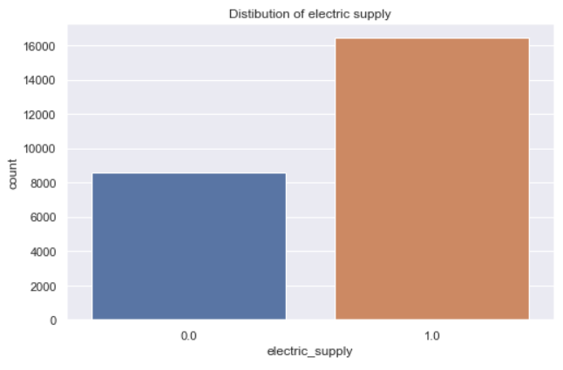
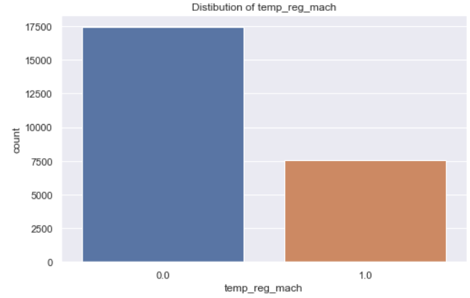



Slide 17
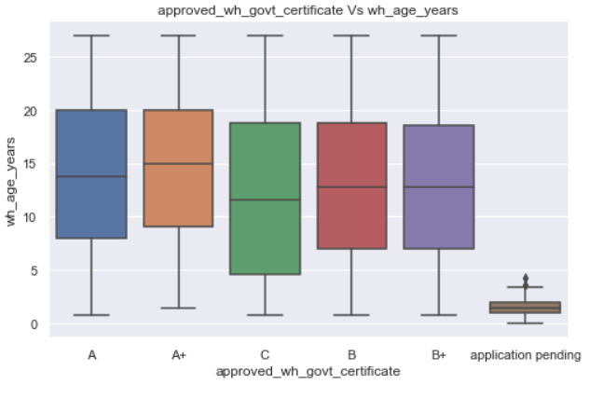
Warehouses with age less than 5 are yet to certified.

Slide 18
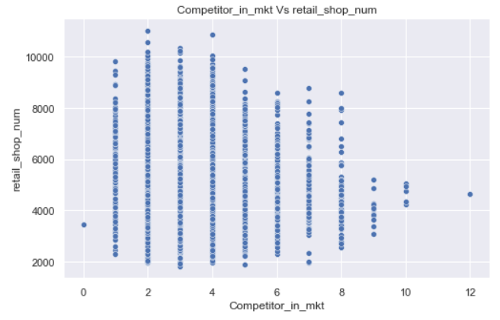
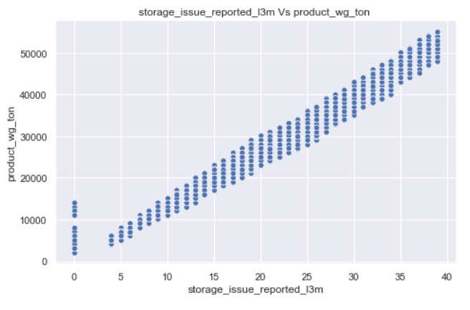
There is a slight reduction in Retail shop number as the No. of Competitors gets increased
There is a positive linear relationship between storage issue reported l3m and the product shipped to warehouse
in tonnes.

Slide 19
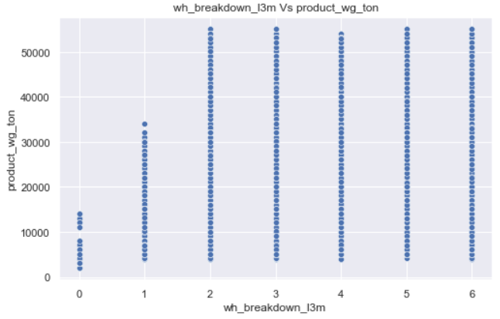
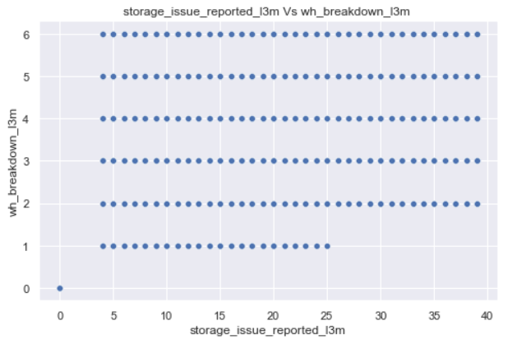
Warehouse breakdowns are higher in warehouses with huge shipment.
Storage issues reported is higher in warehouses with higher breakdowns

Slide 20
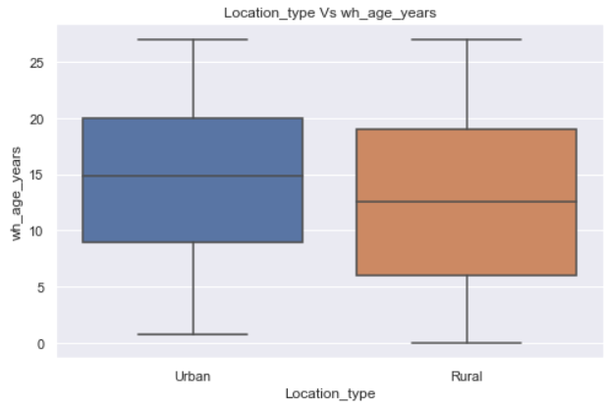
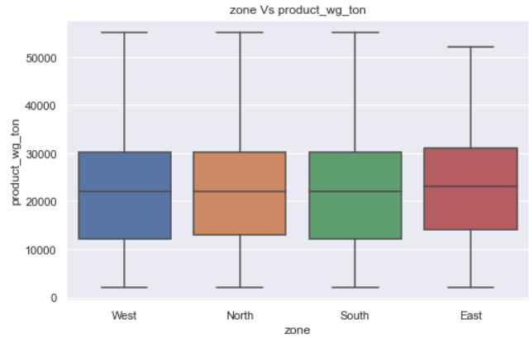
The median age of warehouse is higher in Urban areas
The East zone has higher median product shipment.

Slide 21
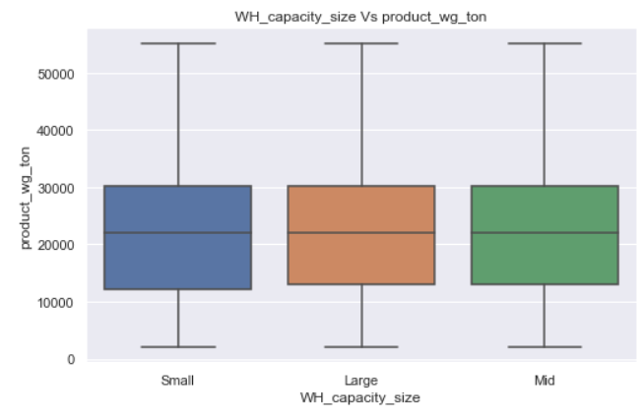
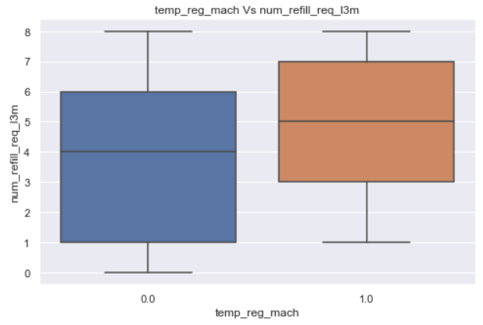
The product weight shipped to warehouses are same irrespective of Warehouse size.
More number of refilling is done in warehouses with temperature regulating machine indicator.

Slide 22
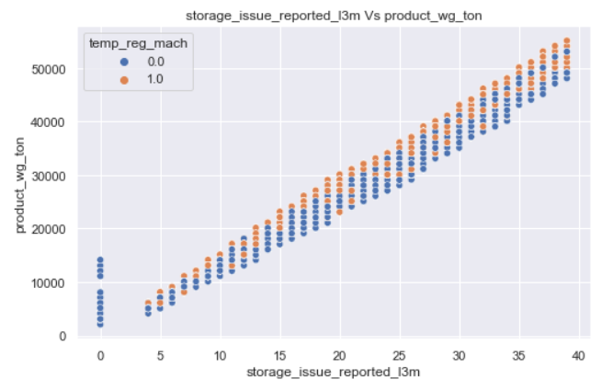
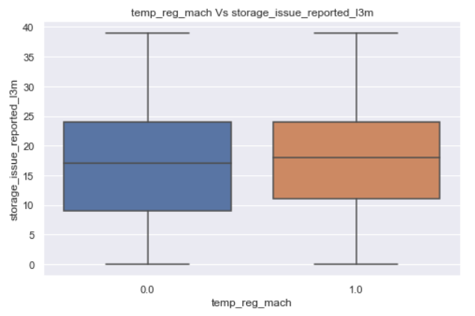
The warehouses with temperature regulating machine indicator received more products and the average storage issue reported is also higher.

Slide 23
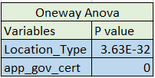
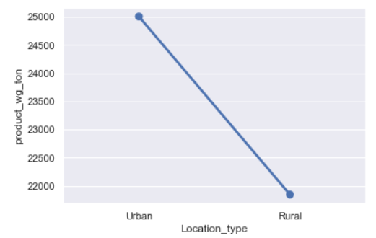
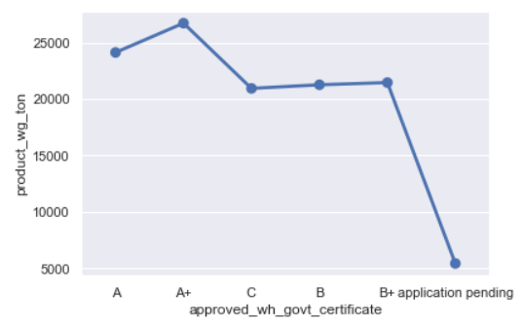
One Way Anova

Slide 24
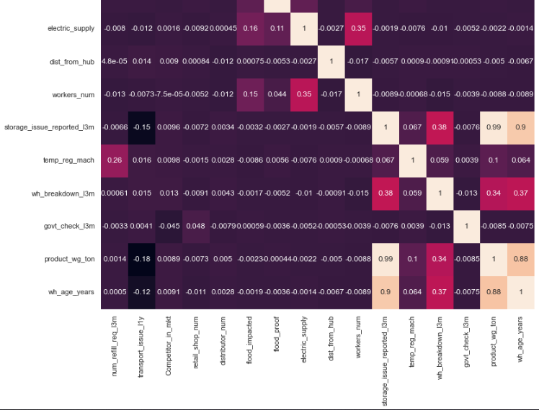
There is a strong correlation between product_wg_ton and storage_issue_reported_l3m.
There is also strong correlation between product_wg_ton and wh_age_years.

Slide 25

CLUSTER PROFILING

Slide 26


Warehouses in cluster 0 received more products even when No. of times refilling required is similar to cluster 1

Slide 27




Warehouse breakdown & storage issue reported is higher in cluster 0.
Clusters are spread in equal ratio in urban and rural areas

Slide 28

Cluster 0 has higher warehouse age
Cluster 1 has lower warehouse age

Slide 29

Warehouses in cluster 0 are all certified warehouse

Slide 30
RECOMMENDATIONS
Warehouses in Cluster 0 are older and the warehouse breakdowns are higher .Measures to be taken to reduce the warehouse breakdowns.
Storage issues reported are also higher in these warehouses with higher shipment.
Despite being supplied products in higher quantity ,the number of refilling required is similar to cluster 1, indicating the fact that these warehouses have higher demand.
The steps to be taken to equip such warehouses with proper storage facilities so that warehouse breakdowns can be reduced.
The supply to warehouses in cluster 1 can be reduced .

